Slide 1

BCAC 0017 FUNDAMENTALS OF MACHINE LEARNING
Section 8 Supervised Learning:
Faculty Name
Mr. Sachin Sharma, Dr. Vinod Jain, Dr. Manu Banga,
Ms.Paromita Goswami, Ms.Chestha Bhardwaj

Slide 2
Section 8 : Supervised Learning:
Supervised Learning:
Support Vector Machine
Decision Tree
Naïve Bayes Classifier.

Slide 3
Supervised Learning:
Supervised Learning:
Supervised learning is the types of machine learning in which machines are trained using well "labelled" training data, and on basis of that data, machines predict the output.
The labelled data means some input data is already tagged with the correct output.

Slide 4
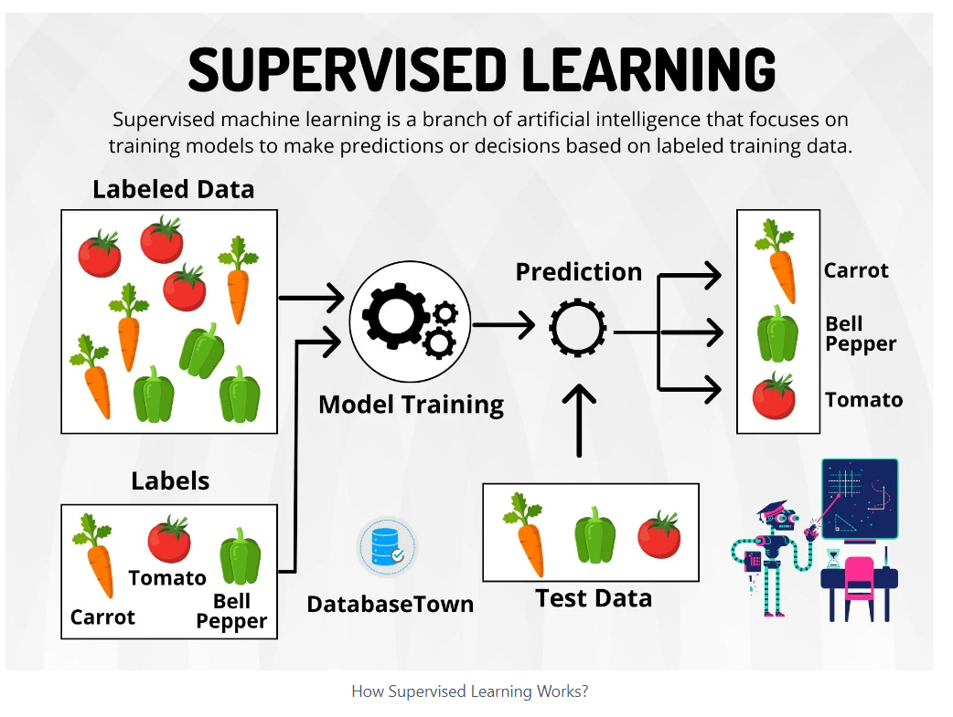

Slide 5
Supervised Learning:
Supervised Learning:
In supervised learning, the training data provided to the machines work as the supervisor that teaches the machines to predict the output correctly.
It applies the same concept as a student learns in the supervision of the teacher.

Slide 6
Supervised Learning:
Supervised Learning:
Supervised learning is a process of providing input data as well as correct output data to the machine learning model.
The aim of a supervised learning algorithm is to find a mapping function to map the input variable(x) with the output variable(y).

Slide 7
Supervised Learning:
How Supervised Learning Works?
In supervised learning, models are trained using labelled dataset, where the model learns about each type of data.
Once the training process is completed, the model is tested on the basis of test data (a subset of the training set), and then it predicts the output.

Slide 8
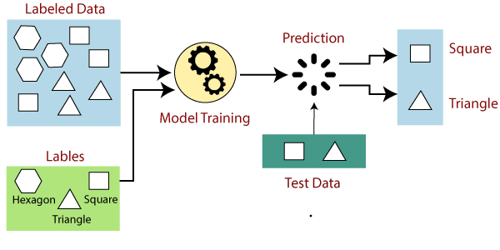

Slide 9
Supervised Learning:
Suppose we have a dataset of different types of shapes which includes square, rectangle, triangle, and Polygon.
Now the first step is that we need to train the model for each shape.
If the given shape has four sides, and all the sides are equal, then it will be labelled as a Square.
If the given shape has three sides, then it will be labelled as a triangle.
If the given shape has six equal sides then it will be labelled as hexagon.

Slide 10
Supervised Learning:
Now, after training, we test our model using the test set, and the task of the model is to identify the shape.
The machine is already trained on all types of shapes, and when it finds a new shape, it classifies the shape on the bases of a number of sides, and predicts the output.

Slide 11
Steps Involved in Supervised Learning:
First Determine the type of training dataset
Collect/Gather the labelled training data.
Split the training dataset into training dataset, test dataset, and validation dataset.
Determine the input features of the training dataset, which should have enough knowledge so that the model can accurately predict the output.
Determine the suitable algorithm for the model, such as support vector machine, decision tree, etc.
Execute the algorithm on the training dataset. Sometimes we need validation sets as the control parameters, which are the subset of training datasets.
Evaluate the accuracy of the model by providing the test set. If the model predicts the correct output, which means our model is accurate.

Slide 12
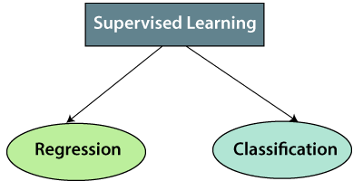
Supervised Learning:
Types of supervised Machine learning Algorithms:
Supervised learning can be further divided into two types of problems:

Slide 13
Supervised Learning:
1. Regression
Regression algorithms are used if there is a relationship between the input variable and the output variable.
It is used for the prediction of continuous variables, such as Weather forecasting, Market Trends, etc.
Below are some popular Regression algorithms which come under supervised learning:
Linear Regression
Regression Trees
Non-Linear Regression
Bayesian Linear Regression
Polynomial Regression

Slide 14
Supervised Learning:
2. Classification
Classification algorithms are used when the output variable is categorical, which means there are two classes such as Yes-No, Male-Female, True-false, etc.
Support Vector Machine
Decision Tree
Naïve Bayes Classifier.
Random Forest
Logistic Regression
Etc.

Slide 15
Supervised Learning:
Advantages of Supervised learning:
With the help of supervised learning, the model can predict the output on the basis of prior experiences.
In supervised learning, we can have an exact idea about the classes of objects.
Supervised learning model helps us to solve various real-world problems such as fraud detection, spam filtering, etc.

Slide 16
Supervised Learning:
Disadvantages of supervised learning:
Supervised learning models are not suitable for handling the complex tasks.
Supervised learning cannot predict the correct output if the test data is different from the training dataset.
Training required lots of computation times.
In supervised learning, we need enough knowledge about the classes of object.

Slide 17
References
https://www.javatpoint.com/supervised-machine-learning

Slide 18
Support Vector Machine
Support Vector Machine or SVM is one of the most popular Supervised Learning algorithms, which is used for Classification as well as Regression problems.
However, primarily, it is used for Classification problems in Machine Learning.

Slide 19
Support Vector Machine
The goal of the SVM algorithm is to create the best line or decision boundary that can segregate n-dimensional space into classes so that we can easily put the new data point in the correct category in the future.
This best decision boundary is called a hyperplane.

Slide 20
Support Vector Machine
SVM chooses the extreme points/vectors that help in creating the hyperplane.
These extreme cases are called as support vectors, and hence algorithm is termed as Support Vector Machine.
Consider the below diagram in which there are two different categories that are classified using a decision boundary or hyperplane:

Slide 21


Slide 22
Support Vector Machine
Hyperplane and Support Vectors in the SVM algorithm:
Hyperplane:
We need to find out the best decision boundary that helps to classify the data points.
This best boundary is known as the hyperplane of SVM.
If there are 2 features (as shown in image), then hyperplane will be a straight line. And if there are 3 features, then hyperplane will be a 2-dimension plane.

Slide 23
Support Vector Machine
Support Vectors:
The data points or vectors that are the closest to the hyperplane and which affect the position of the hyperplane are termed as Support Vector.
Since these vectors support the hyperplane, hence called a Support vector.

Slide 24
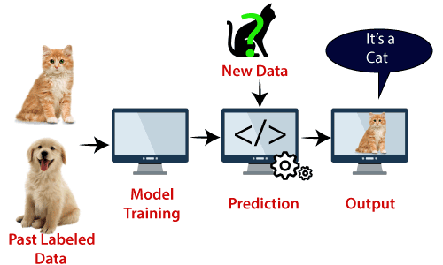
Support Vector Machine

Slide 25
Support Vector Machine
Example
Suppose we see a strange cat that also has some features of dogs, so if we want a model that can accurately identify whether it is a cat or dog, so such a model can be created by using the SVM algorithm.
We will first train our model with lots of images of cats and dogs so that it can learn about different features of cats and dogs, and then we test it with this strange creature.
So as support vector creates a decision boundary between these two data (cat and dog) and choose extreme cases (support vectors), it will see the extreme case of cat and dog. On the basis of the support vectors, it will classify it as a cat. Consider the below diagram:

Slide 26
Support Vector Machine
SVM algorithm can be used for Face detection, image classification, text categorization, etc.

Slide 27
Support Vector Machine
SVM can be of two types:
Linear SVM: Linear SVM is used for linearly separable data, which means if a dataset can be classified into two classes by using a single straight line, then such data is termed as linearly separable data, and classifier is used called as Linear SVM classifier.
Non-linear SVM: Non-Linear SVM is used for non-linearly separated data, which means if a dataset cannot be classified by using a straight line, then such data is termed as non-linear data and classifier used is called as Non-linear SVM classifier.

Slide 28
# SVM
# https://www.javatpoint.com/machine-learning-support-vector-machine-algorithm
#Data Pre-processing Step
# importing libraries
import numpy as nm
import matplotlib.pyplot as mtp
import pandas as pd
#importing datasets
data_set= pd.read_csv('user_data.csv')
#Extracting Independent and dependent Variable
x= data_set.iloc[:, [2,3]].values
y= data_set.iloc[:, 4].values
# Splitting the dataset into training and test set.
from sklearn.model_selection import train_test_split
x_train, x_test, y_train, y_test= train_test_split(x, y, test_size= 0.25, random_state=0)
#feature Scaling
from sklearn.preprocessing import StandardScaler
st_x= StandardScaler()
x_train= st_x.fit_transform(x_train)
x_test= st_x.transform(x_test)

Slide 29
from sklearn.svm import SVC # "Support vector classifier"
classifier = SVC(kernel='linear', random_state=0)
classifier.fit(x_train, y_train)
#Predicting the test set result
y_pred= classifier.predict(x_test)
#Creating the Confusion matrix
from sklearn.metrics import confusion_matrix
cm= confusion_matrix(y_test, y_pred)
print("Confusion Matrix is : ")
print(cm)
from sklearn.metrics import accuracy_score
score =accuracy_score(y_pred, y_test)
print("Test Accuracy Score ")
print(score)
Confusion Matrix is :
[[66 2]
[ 8 24]]
Test Accuracy Score
0.9

Slide 30
Example 2

Slide 31
# SVM
# https://www.geeksforgeeks.org/introduction-to-support-vector-machines-svm/
import numpy as np
from sklearn.datasets import make_classification
from sklearn import svm
from sklearn.model_selection import train_test_split
classes = 4
X,t= make_classification(100, 5, n_classes = classes, random_state= 40, n_informative = 2, n_clusters_per_class = 1)
X_train, X_test, y_train, y_test= train_test_split(X, t , test_size=0.50)
model = svm.SVC(kernel = 'linear', random_state = 0, C=1.0)
model.fit(X_train, y_train)
y=model.predict(X_test)
y2=model.predict(X_train)

Slide 32
from sklearn.metrics import accuracy_score
score =accuracy_score(y, y_test)
print("Test Accuracy Score ")
print(score)
print("Train Accuracy Score ")
score2 =accuracy_score(y2, y_train)
print(score2)
Test Accuracy Score
0.88
Train Accuracy Score
0.96

Slide 33
# Visualization of results.
import matplotlib.pyplot as plt
color = ['black' if c == 0 else 'lightgrey' for c in y]
plt.scatter(X_train[:,0], X_train[:,1], c=color)
# Create the hyperplane
w = model.coef_[0]
a = -w[0] / w[1]
xx = np.linspace(-2.5, 2.5)
yy = a * xx - (model.intercept_[0]) / w[1]
# Plot the hyperplane
plt.plot(xx, yy)
plt.axis("off"), plt.show();

Slide 34
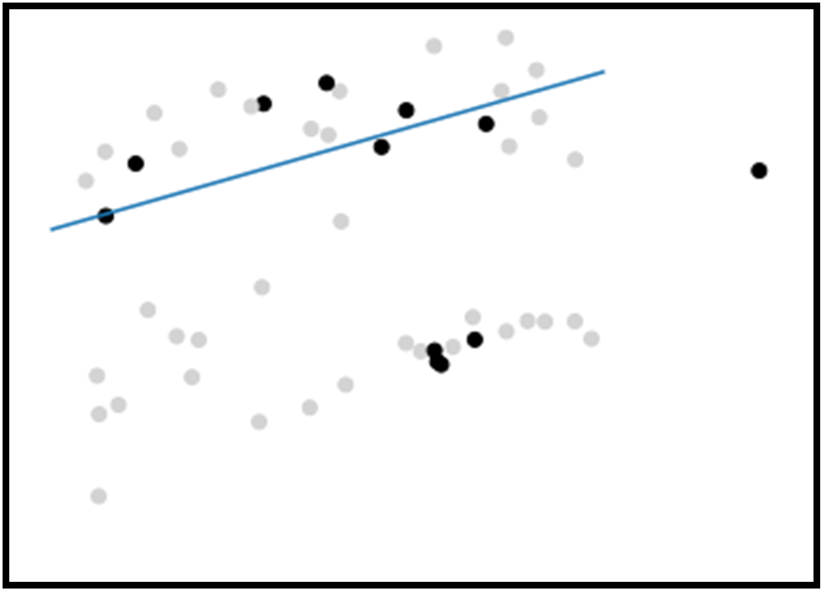

Slide 35
Support Vector Machine Code
# SVM
# https://www.geeksforgeeks.org/introduction-to-support-vector-machines-svm/
import numpy as np
from sklearn.datasets import make_classification
from sklearn import svm
from sklearn.model_selection import train_test_split
classes = 4
X,t= make_classification(100, 5, n_classes = classes, random_state= 40, n_informative = 2, n_clusters_per_class = 1)
X_train, X_test, y_train, y_test= train_test_split(X, t , test_size=0.50)
model = svm.SVC(kernel = 'linear', random_state = 0, C=1.0)
model.fit(X_train, y_train)
y=model.predict(X_test)
y2=model.predict(X_train)
from sklearn.metrics import accuracy_score
score =accuracy_score(y, y_test)
print("Test Accuracy Score ")
print(score)
print("Train Accuracy Score ")
score2 =accuracy_score(y2, y_train)
print(score2)
import matplotlib.pyplot as plt
color = ['black' if c == 0 else 'lightgrey' for c in y]
plt.scatter(X_train[:,0], X_train[:,1], c=color)
# Create the hyperplane
w = model.coef_[0]
a = -w[0] / w[1]
xx = np.linspace(-2.5, 2.5)
yy = a * xx - (model.intercept_[0]) / w[1]
# Plot the hyperplane
plt.plot(xx, yy)
plt.axis("off"), plt.show();

Slide 36
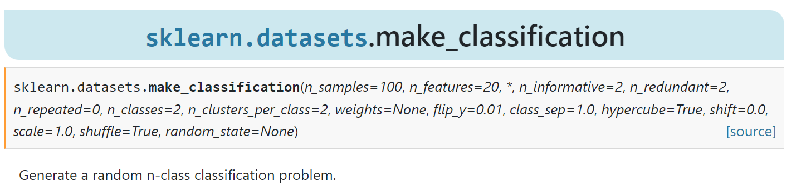
sklearn.datasets.make_classification
https://scikit-learn.org/stable/modules/generated/sklearn.datasets.make_classification.html

Slide 37
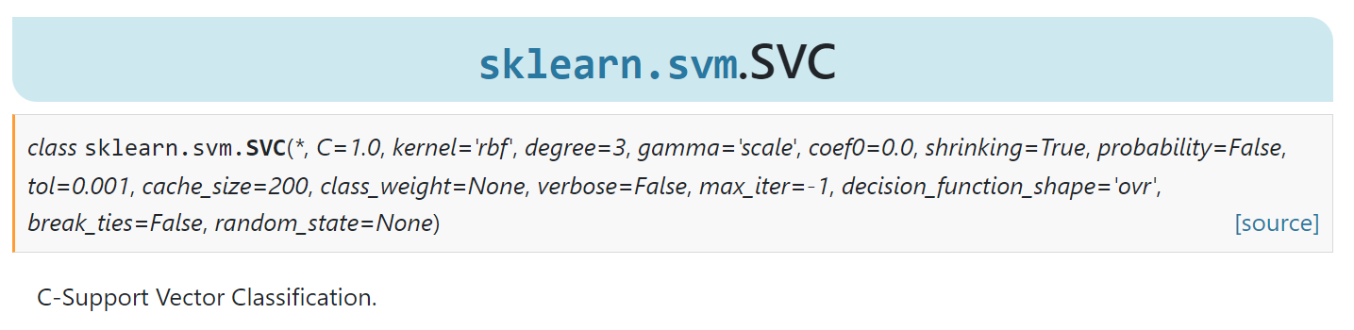
sklearn.svm.SVC Support Vector Classification.
https://scikit-learn.org/stable/modules/generated/sklearn.svm.SVC.html

Slide 38
References
https://www.geeksforgeeks.org/introduction-to-support-vector-machines-svm/
https://www.geeksforgeeks.org/support-vector-machine-algorithm/

Slide 39
Decision Tree
Decision Tree is a Supervised learning technique that can be used for both classification and Regression problems, but mostly it is preferred for solving Classification problems.

Slide 40
Decision Tree
It is a tree-structured classifier, where internal nodes represent the features of a dataset, branches represent the decision rules and each leaf node represents the outcome.

Slide 41


Slide 42
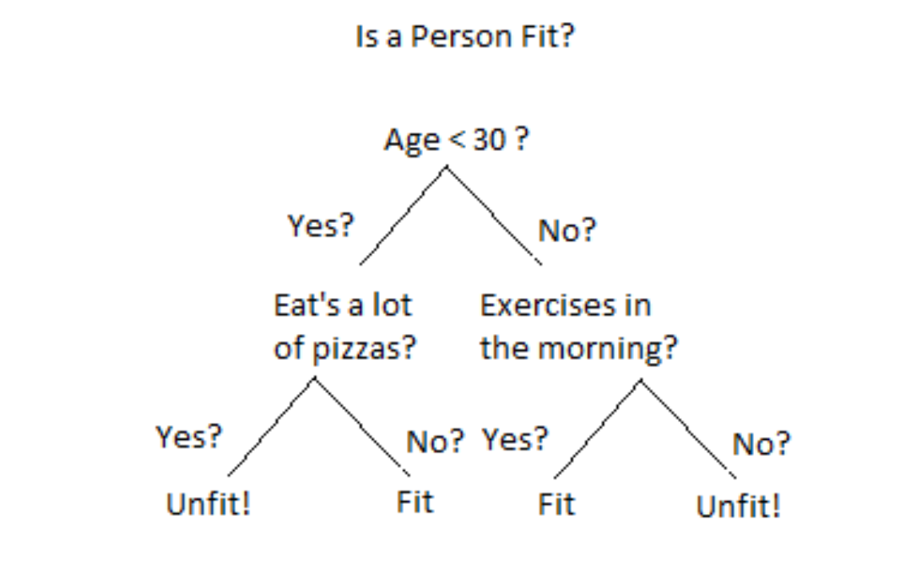

Slide 43
Decision Tree
In a Decision tree, there are two nodes, which are the Decision Node and Leaf Node. Decision nodes are used to make any decision and have multiple branches, whereas Leaf nodes are the output of those decisions and do not contain any further branches.
The decisions or the test are performed on the basis of features of the given dataset.

Slide 44
Decision Tree
It is a graphical representation for getting all the possible solutions to a problem/decision based on given conditions.
It is called a decision tree because, similar to a tree, it starts with the root node, which expands on further branches and constructs a tree-like structure.

Slide 45
Decision Tree
Why use Decision Trees?
Below are the two reasons for using the Decision tree:
Decision Trees usually mimic human thinking ability while making a decision, so it is easy to understand.
The logic behind the decision tree can be easily understood because it shows a tree-like structure.

Slide 46
Decision Tree Terminologies
Root Node: Root node is from where the decision tree starts. It represents the entire dataset, which further gets divided into two or more homogeneous sets.
Leaf Node: Leaf nodes are the final output node, and the tree cannot be segregated further after getting a leaf node.
Splitting: Splitting is the process of dividing the decision node/root node into sub-nodes according to the given conditions.

Slide 47
Decision Tree Terminologies
Branch/Sub Tree: A tree formed by splitting the tree.
Pruning: Pruning is the process of removing the unwanted branches from the tree.
Parent/Child node: The root node of the tree is called the parent node, and other nodes are called the child nodes.

Slide 48
How does the Decision Tree algorithm Work?
Step-1: Begin the tree with the root node, says S, which contains the complete dataset.
Step-2: Find the best attribute in the dataset using Attribute Selection Measure (ASM).
Step-3: Divide the S into subsets that contains possible values for the best attributes.
Step-4: Generate the decision tree node, which contains the best attribute.
Step-5: Recursively make new decision trees using the subsets of the dataset created in step -3. Continue this process until a stage is reached where you cannot further classify the nodes and called the final node as a leaf node.

Slide 49
Decision Tree
Example: Suppose there is a candidate who has a job offer and wants to decide whether he should accept the offer or Not.
So, to solve this problem, the decision tree starts with the root node (Salary attribute by ASM).
The root node splits further into the next decision node (distance from the office) and one leaf node based on the corresponding labels.
The next decision node further gets split into one decision node (Cab facility) and one leaf node.
Finally, the decision node splits into two leaf nodes (Accepted offers and Declined offer). Consider the below diagram:

Slide 50
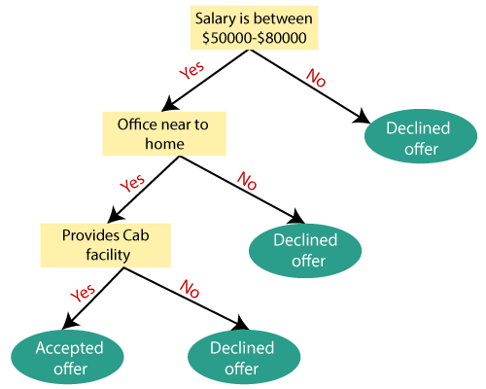

Slide 51
Decision Tree
Advantages of the Decision Tree
It is simple to understand as it follows the same process which a human follow while making any decision in real-life.
It can be very useful for solving decision-related problems.
It helps to think about all the possible outcomes for a problem.
There is less requirement of data cleaning compared to other algorithms.

Slide 52
Decision Tree
Disadvantages of the Decision Tree
The decision tree contains lots of layers, which makes it complex.
It may have an overfitting issue, which can be resolved using the Random Forest algorithm.
For more class labels, the computational complexity of the decision tree may increase.

Slide 53
Python Implementation of Decision Tree
Now we will implement the Decision tree using Python. For this, we will use the dataset "user_data.csv," which we have used in previous classification models.
By using the same dataset, we can compare the Decision tree classifier with other classification models such as KNN SVM, LogisticRegression, etc.

Slide 54
Decision Tree
Steps will also remain the same, which are given below:
Data Pre-processing step
Fitting a Decision-Tree algorithm to the Training set
Predicting the test result
Test accuracy of the result(Creation of Confusion matrix)
Visualizing the test set result.

Slide 55
######### Decision Tree 1
# https://www.javatpoint.com/machine-learning-decision-tree-classification-algorithm
# importing libraries
import numpy as nm
import matplotlib.pyplot as mtp
import pandas as pd
#importing datasets
data_set= pd.read_csv('user_data.csv')
# data Set Download
# https://www.kaggle.com/datasets/erscodingzone/user-datacsv
#Extracting Independent and dependent Variable
x= data_set.iloc[:, [2,3]].values
y= data_set.iloc[:, 4].values
# Splitting the dataset into training and test set.
from sklearn.model_selection import train_test_split
x_train, x_test, y_train, y_test= train_test_split(x, y, test_size= 0.25, random_state=0)

Slide 56
#feature Scaling
from sklearn.preprocessing import StandardScaler
st_x= StandardScaler()
x_train= st_x.fit_transform(x_train)
x_test= st_x.transform(x_test)
#Fitting Decision Tree classifier to the training set
from sklearn.tree import DecisionTreeClassifier
classifier= DecisionTreeClassifier(criterion='entropy', random_state=0)
classifier.fit(x_train, y_train)

Slide 57
#Predicting the test set result
y_pred= classifier.predict(x_test)
#Creating the Confusion matrix
from sklearn.metrics import confusion_matrix
cm= confusion_matrix(y_test, y_pred)
print(cm)
from sklearn.metrics import accuracy_score
score =accuracy_score(y_pred, y_test)
print("Test Accuracy Score ")
print(score)
Confusion Matrix is :
[[62 6]
[ 3 29]]
Test Accuracy Score
0.91

Slide 58
Decision Tree : Code
######### Decision Tree 1
# https://www.javatpoint.com/machine-learning-decision-tree-classification-algorithm
# importing libraries
import numpy as nm
import matplotlib.pyplot as mtp
import pandas as pd
#importing datasets
data_set= pd.read_csv('user_data.csv')
# data Set Download
# https://www.kaggle.com/datasets/erscodingzone/user-datacsv
#Extracting Independent and dependent Variable
x= data_set.iloc[:, [2,3]].values
y= data_set.iloc[:, 4].values
# Splitting the dataset into training and test set.
from sklearn.model_selection import train_test_split
x_train, x_test, y_train, y_test= train_test_split(x, y, test_size= 0.25, random_state=0)
#feature Scaling
from sklearn.preprocessing import StandardScaler
st_x= StandardScaler()
x_train= st_x.fit_transform(x_train)
x_test= st_x.transform(x_test)
#Fitting Decision Tree classifier to the training set
from sklearn.tree import DecisionTreeClassifier
classifier= DecisionTreeClassifier(criterion='entropy', random_state=0)
classifier.fit(x_train, y_train)
#Predicting the test set result
y_pred= classifier.predict(x_test)
#Creating the Confusion matrix
from sklearn.metrics import confusion_matrix
cm= confusion_matrix(y_test, y_pred)
print("Confusion Matrix is : ")
print(cm)
from sklearn.metrics import accuracy_score
score =accuracy_score(y_pred, y_test)
print("Test Accuracy Score ")
print(score)

Slide 59
References
https://www.kaggle.com/datasets/erscodingzone/user-datacsv
https://www.javatpoint.com/machine-learning-decision-tree-classification-algorithm

Slide 60
Naïve Bayes Classifier.
Naïve Bayes algorithm is a supervised learning algorithm, which is based on Bayes theorem and used for solving classification problems.
It is mainly used in text classification that includes a high-dimensional training dataset.

Slide 61
Naïve Bayes Classifier.
Naïve Bayes Classifier is one of the simple and most effective Classification algorithms which helps in building the fast machine learning models that can make quick predictions.
It is a probabilistic classifier, which means it predicts on the basis of the probability of an object.
Some popular examples of Naïve Bayes Algorithm are spam filtration, Sentimental analysis, and classifying articles.

Slide 62
Naïve Bayes Classifier.
Why is it called Naïve Bayes?
The Naïve Bayes algorithm is comprised of two words Naïve and Bayes, Which can be described as:
Naïve: It is called Naïve because it assumes that the occurrence of a certain feature is independent of the occurrence of other features. Such as if the fruit is identified on the bases of color, shape, and taste, then red, spherical, and sweet fruit is recognized as an apple. Hence each feature individually contributes to identify that it is an apple without depending on each other.
Bayes: It is called Bayes because it depends on the principle of Bayes' Theorem.

Slide 63
Naïve Bayes Classifier.
Working of Naïve Bayes' Classifier:
Working of Naïve Bayes' Classifier can be understood with the help of the below example:
Suppose we have a dataset of weather conditions and corresponding target variable "Play". So using this dataset we need to decide that whether we should play or not on a particular day according to the weather conditions. So to solve this problem, we need to follow the below steps:
Convert the given dataset into frequency tables.
Generate Likelihood table by finding the probabilities of given features.
Now, use Bayes theorem to calculate the posterior probability.
Problem: If the weather is sunny, then the Player should play or not?
Solution: To solve this, first consider the below dataset:

Slide 64
Naïve Bayes Classifier.
Advantages of Naïve Bayes Classifier:
Naïve Bayes is one of the fast and easy ML algorithms to predict a class of datasets.
It can be used for Binary as well as Multi-class Classifications.
It performs well in Multi-class predictions as compared to the other Algorithms.
It is the most popular choice for text classification problems.
Disadvantages of Naïve Bayes Classifier:
Naive Bayes assumes that all features are independent or unrelated, so it cannot learn the relationship between features.

Slide 65
Naïve Bayes Classifier.
Applications of Naïve Bayes Classifier:
It is used for Credit Scoring.
It is used in medical data classification.
It can be used in real-time predictions because Naïve Bayes Classifier is an eager learner.
It is used in Text classification such as Spam filtering and Sentiment analysis.

Slide 66
Naïve Bayes Classifier.
Types of Naïve Bayes Model:
There are three types of Naive Bayes Model, which are given below:
Gaussian: The Gaussian model assumes that features follow a normal distribution. This means if predictors take continuous values instead of discrete, then the model assumes that these values are sampled from the Gaussian distribution.
Multinomial: The Multinomial Naïve Bayes classifier is used when the data is multinomial distributed. It is primarily used for document classification problems, it means a particular document belongs to which category such as Sports, Politics, education, etc. The classifier uses the frequency of words for the predictors.
Bernoulli: The Bernoulli classifier works similar to the Multinomial classifier, but the predictor variables are the independent Booleans variables. Such as if a particular word is present or not in a document. This model is also famous for document classification tasks.

Slide 67
Python Implementation of the Naïve Bayes algorithm:
Steps to implement:
Data Pre-processing step
Fitting Naive Bayes to the Training set
Predicting the test result
Test accuracy of the result(Creation of Confusion matrix)
Visualizing the test set result.

Slide 68
## Python Implementation of the Naïve Bayes algorithm:
# importing the libraries
import numpy as nm
import matplotlib.pyplot as mtp
import pandas as pd
#importing datasets
# data Set Download
# https://www.kaggle.com/datasets/erscodingzone/user-datacsv
dataset = pd.read_csv('user_data.csv')
x = dataset.iloc[:, [2, 3]].values
y = dataset.iloc[:, 4].values

Slide 69
# Splitting the dataset into the Training set and Test set
from sklearn.model_selection import train_test_split
x_train, x_test, y_train, y_test = train_test_split(x, y, test_size = 0.25, random_state = 0)
# Feature Scaling
from sklearn.preprocessing import StandardScaler
sc = StandardScaler()
x_train = sc.fit_transform(x_train)
x_test = sc.transform(x_test)
# Fitting Naive Bayes to the Training set
from sklearn.naive_bayes import GaussianNB
classifier = GaussianNB()
classifier.fit(x_train, y_train)
# Predicting the Test set results
y_pred = classifier.predict(x_test)

Slide 70
# Making the Confusion Matrix
from sklearn.metrics import confusion_matrix
cm = confusion_matrix(y_test, y_pred)
print("Confusion Matrix is : ")
print(cm)
from sklearn.metrics import accuracy_score
score =accuracy_score(y_pred, y_test)
print("Test Accuracy Score ")
print(score)
Confusion Matrix is :
[[65 3]
[ 7 25]]
Test Accuracy Score
0.9

Slide 71
References
# https://www.kaggle.com/datasets/erscodingzone/user-datacsv
https://www.javatpoint.com/machine-learning-naive-bayes-classifier

Slide 72
END

